Slide 1



IBM SKILLSBUILD – TNSDC
We will start the session by 10 AM
Digital Skills
Week - 6

Slide 2
IBM SKILLSBUILD – TNSDC
Digital Skills
Week - 03

Slide 3
IBM SKILLSBUILD – TNSDC
We will start the session by 2pm
Digital Skills
Student Orientation Program

Slide 4


Edunet Foundation
About Us
What do we do
Founded in 2015, as a not-profit.Registered u/s 12AA and 80G of Income Tax Act
Thematic Areas of Engagement: Education and Skilling
Large network of institutions enabled through academic and government partnerships
Special Consultative Status with the Economic and Social Council (ECOSOC) of the United Nations since 2020
Extensive experience of content development, capacity building, implementation etc.
Over 650,000 learners directly impacted since 2018 through our programs
We are Great Place to Work Certified – 3 Years in a row!
Programs across academic spectrum – for schools, vocational institutes, for technical or non-technical colleges & for out of education learners
We have a NICHE! - Technology anchored education / skilling programs which leads to be better employability in tech enabled job roles.
Majority of our program audiences represent beneficiaries from Tier 2/3 colleges and cities. Some programs have focus on beneficiaries from EWS categories as well
Drive implementation of CSR programs from corporates – IBM, Microsoft, SAP, Vodafone Idea Foundation, Ernst & Young (GDS), LTIMindtree, TCS, Aditya Birla Group etc.

Slide 5
Agenda
Program Overview
Registration on IBM SkillsBuild
Student Process from Naan Mudhalvan
Edunet Student Dashboard
Features of Student Dashboard

Slide 6
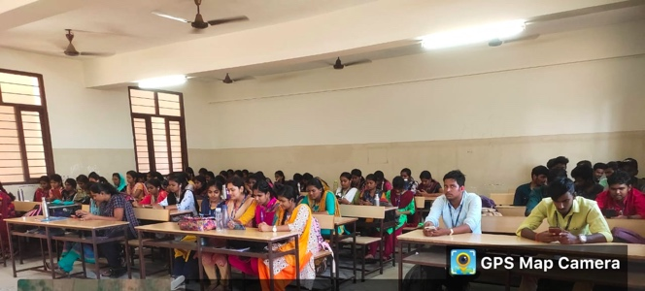
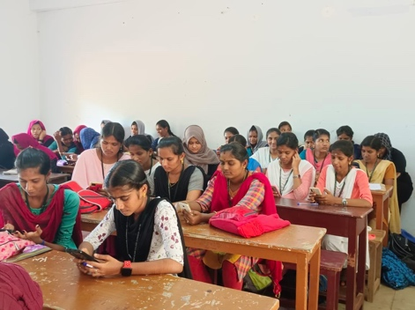
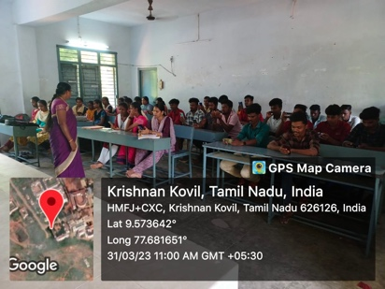
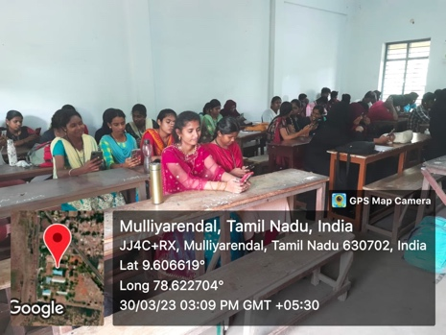
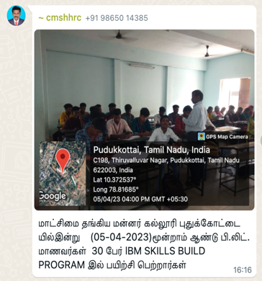
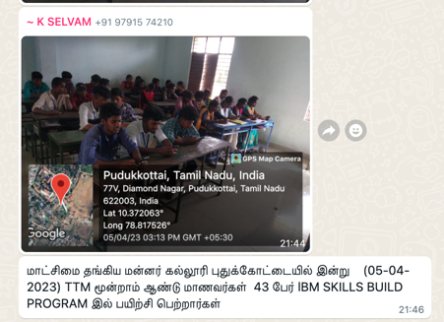
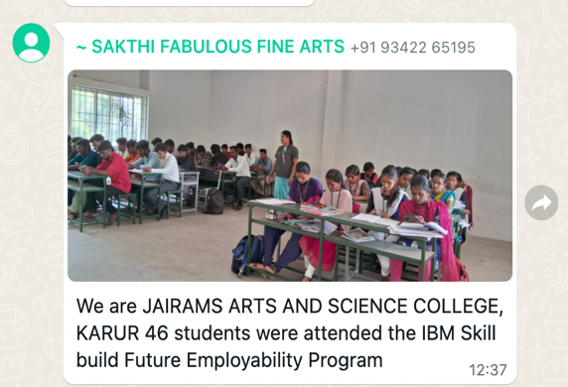
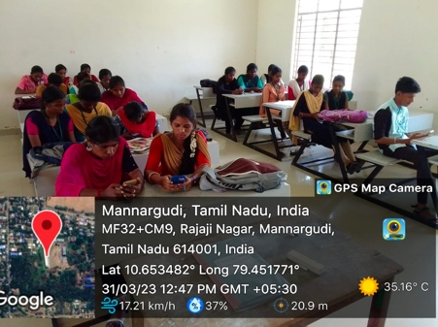
Snapshots from Across the State
Notes:
We are pleased to share a glimpse of the highly engaging sessions that took place during the months of March, April, and May. These captivating photos capture the enthusiasm and active participation of students from across various states. It is evident that the sessions were not only educational but also provided an enjoyable and enriching experience for all involved.

Slide 7


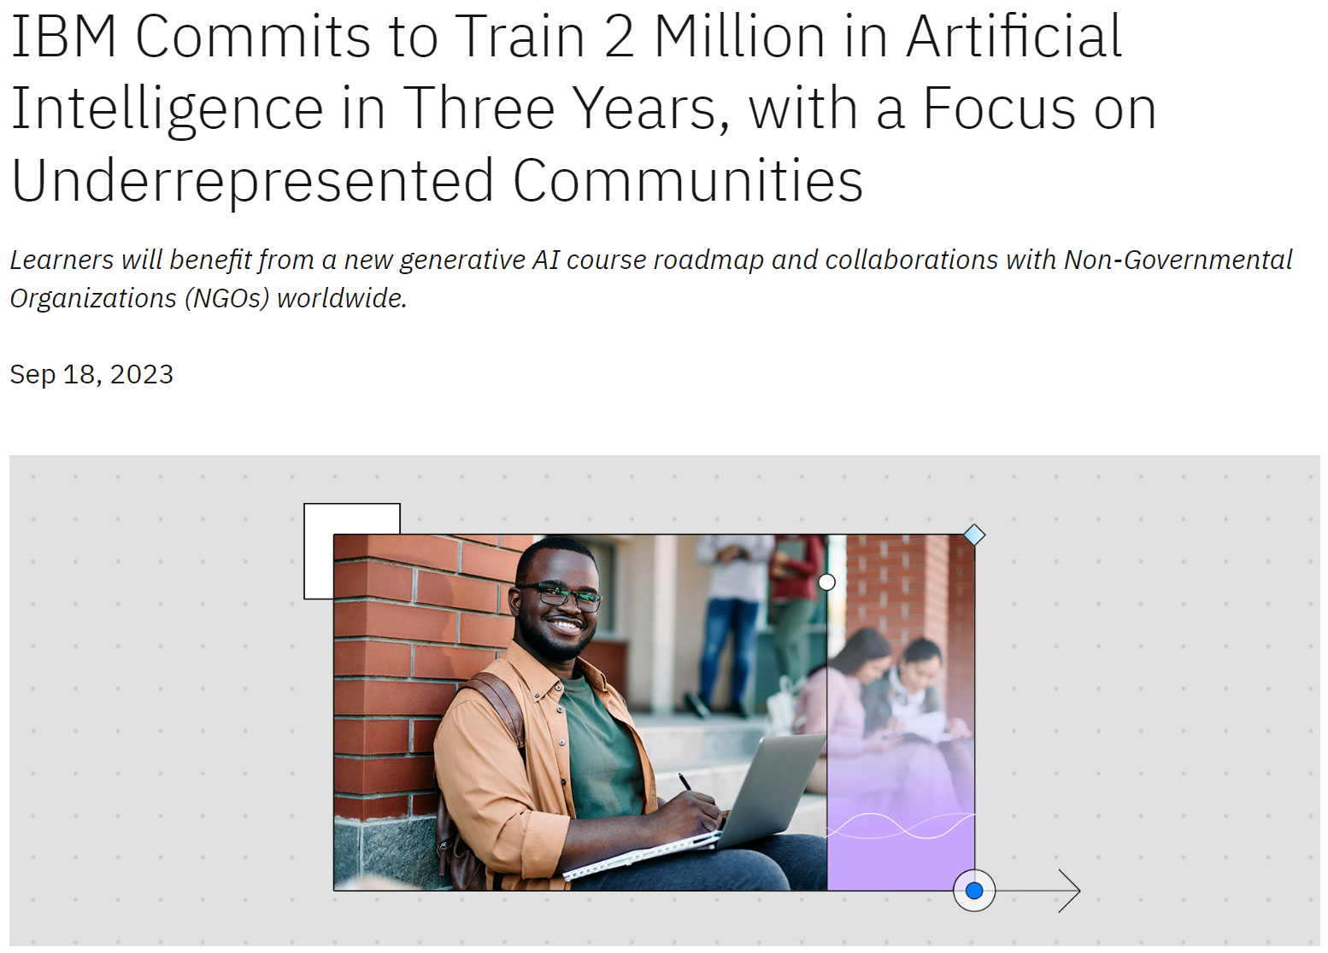
“Closing the global skills gap is one of the most pressing issues of our time”
- Arvind Krishna, IBM, Chairman and CEO​
Notes:
IBM

Slide 8
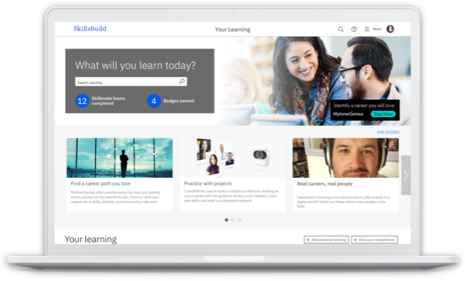
IBM SkillsBuild For Adults
A free digital platform that gives every adult the opportunity to develop technology and professional skills regardless of your background, education, or life experiences.
A comprehensive ecosystem to support:
Learning needs – Over thousands of courses with certification and badges from IBM
Hands-on Learning experiences – opportunities to participate in the project-based learning and industry mentorships
Access to employment – opportunities to join digital work / job fairs for placement opportunities
816,910+
Learners Onboarded
24,500+
Pathways to career
941,686+
Course Completions
976,977+
Learning Hours
Notes:
NOTE FOR TRAINER
- Demo of the IBM SkillsBuild Platform
- Show case of variety of courses available and what students can pursue after the program has completed
Features and benefits Social Media Showcase
Lifetime Access
Skills Essential for Entry-Level Jobs
Internship and project-based Learning
10000+ Courses - Self-based Learning
Interactive and Multi-media Course Material
Content for Educators
Faculty Development Programs & Teacher Resources
Industry Recognized Certificates Badges

Slide 9
Instructor-Led Course Content Outline for 8 weeks
IBM SKILLS BUILD FOR ADULTS – TNSDC
DIGITAL SKILLS

Slide 10

Program Overview
8-weeks program for the students
Advanced learning of technologies with free certificates
Activity based learning
Digital Skills
Equipping Students with Modern Skills
Starting 20th January 2025, Monday

Slide 11
Program Learning Objectives
Developing
Exploring
Explore in-depth expertise in Microsoft Word, Excel, and PowerPoint, covering both foundational and advanced features.
Understand the fundamentals of document creation, editing, and formatting.
Embracing
Enhance documents with multimedia elements, including images, captions, icons, and mathematical symbols.
Develop storytelling and narrative skills for delivering impactful and persuasive presentations.
Understanding
Learning
Learn data entry, table creation, and formatting techniques for effective data management.
Project Work – Submitting Doc and Completing Assessment

Slide 12
Content-Based Duration
Theory/Practical | Duration
Theoretical | 4 hours approx.
Practical/Hands-On | 12 hours
Project (Self-paced) | 20 hours
Self Paced Learning (IBM SkillsBuild) | 14 hours
Total Duration | 50 hours Approx.

Slide 13
Pre- Requisites for student sessions: System requirements
A Computer System (PC/Laptop) with Windows/Linux and the following preferred requirements:
RAM size - 2GB or more,
HDD size - 20 GB free disk space is required,
High-speed internet connection (1 Mbps recommended),
Compatibility with the following software
MS Office

Slide 14
Week-Wise Implementation
Mentor-Led Sessions with IBM Courses
Completion of Program Activity + IBM Courses
Submission
Information sharing
Orientation & Registration
Week 0
Week 1
Week 2-6
Week 7- 8
Week 9+
6. Hands-on Activities
10. Initiation of Certification
2. Faculty Development Program
3. Student Orientation
7. Self-paced Learning Completion
9. Reporting and Review with TNSDC
1. Program initiation
4. Self-paced
learning
5.Training begins
8. Submission of Program Assessment

Slide 15
Proposed Session Calendar
Week | Dates | Topic
Week 1 | 20th & 21st January, 2025 | Introduction to Skills Build
Week 2 | 27th & 28th January, 2025 | Introduction to Microsoft Word
Week 3 | 3rd & 4th February, 2025 | Introduction to Microsoft Power Point
Week 4 | 10th & 11th February, 2025 | Introduction to Microsoft Excel
Week 5 | 17th & 18th February, 2025 | Data Visualization using Excel
Week 6 | 24th & 25th February, 2025 | Basic Introduction on AI
Week 7 | 3rd & 4th March, 2025 | Use of AI in MS Word, Power Point
Week 8 | 10th & 11th March,2025 | Uses of AI in Excel
Points to Note
Session in a Week | Monday, Tuesday
Sessions in a day | 2
Timing of sessions | 10:00 AM- 12:00 PM 02:00 PM – 04:00 PM
Notes:
Whenever you have NM day, your students can join
PDF will contain
College Code
College Name
Number of students
Assigned Day
Slot for Session

Slide 16
Proposed Student Session Timings
Day | Timings
Monday & Tuesday | 10:00 AM – 12:00 PM
 | 02:00 PM – 04:00 PM
Note: Students from one college need to join one slot in a day. Same content will be delivered in both the slots in same day.
Notes:
During the FDP the 5 participating universities will be invited to select a batch slot based on the table shown below. Only one batch can occupy a slot at a time as sessions cannot be take simultaneously.
The master trainers travelling to the Universities will connect with the local SPOC days prior to travelling to the location to ensure the preparation at the university.

Slide 17
IBM SkillsBuild Registration Process
Demonstration

Slide 18



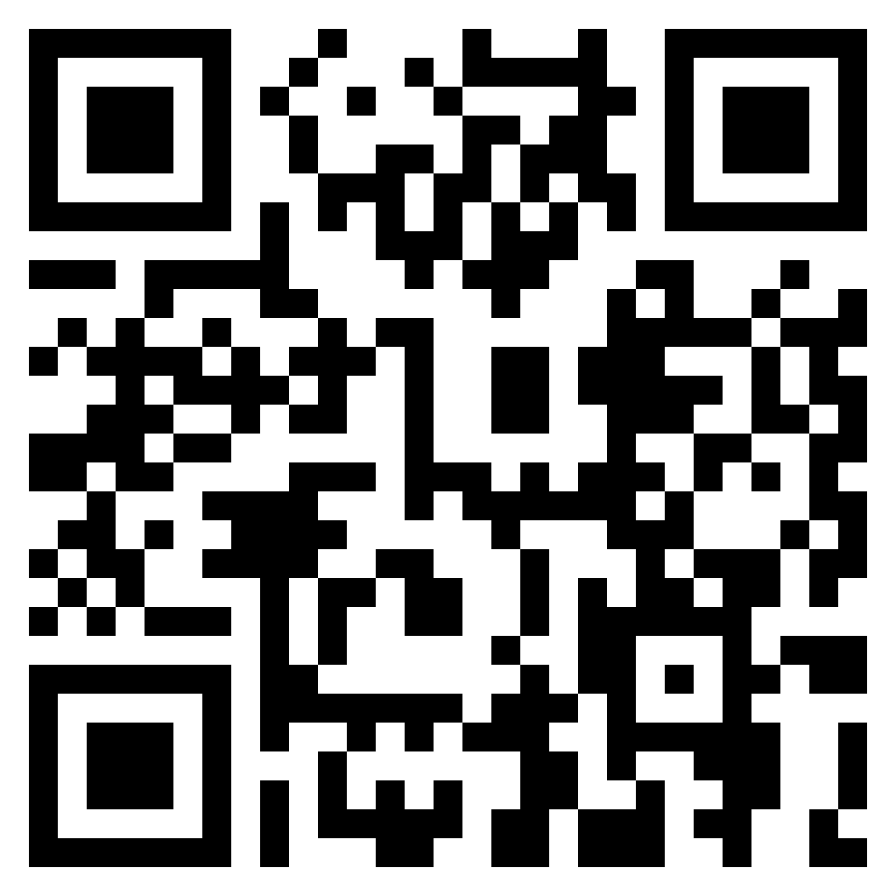
Registering your Google (Gmail Id) for e-learning material
Scan QR Code
Notes:
Self-Registration Link: https://sb-auth.skillsbuild.org/signup?ngo-id=0107
IBM SkillsBuild YouTube Video Guides:
How to Register on SkillsBuild: https://youtu.be/r7lVgQE7618 Welcome to SkillsBuild: https://youtu.be/QASgLUn9dWw Finding a course: https://youtu.be/WuN8mlAaOTw
Orientation Certification Link - https://skills.yourlearning.ibm.com/activity/PLAN-04138CD348A7

Slide 19
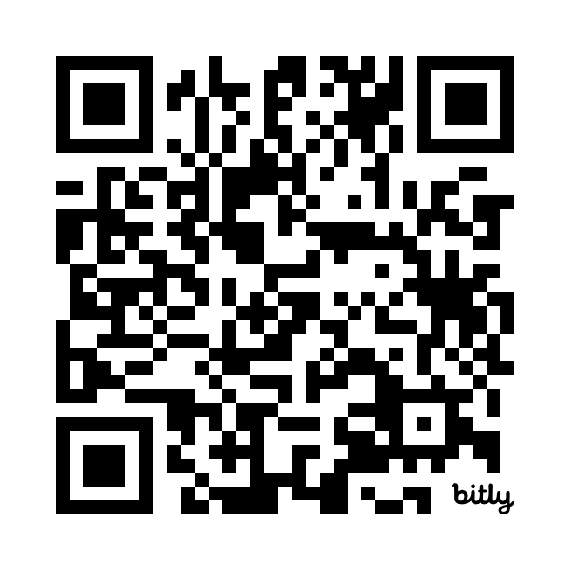

Slide 20
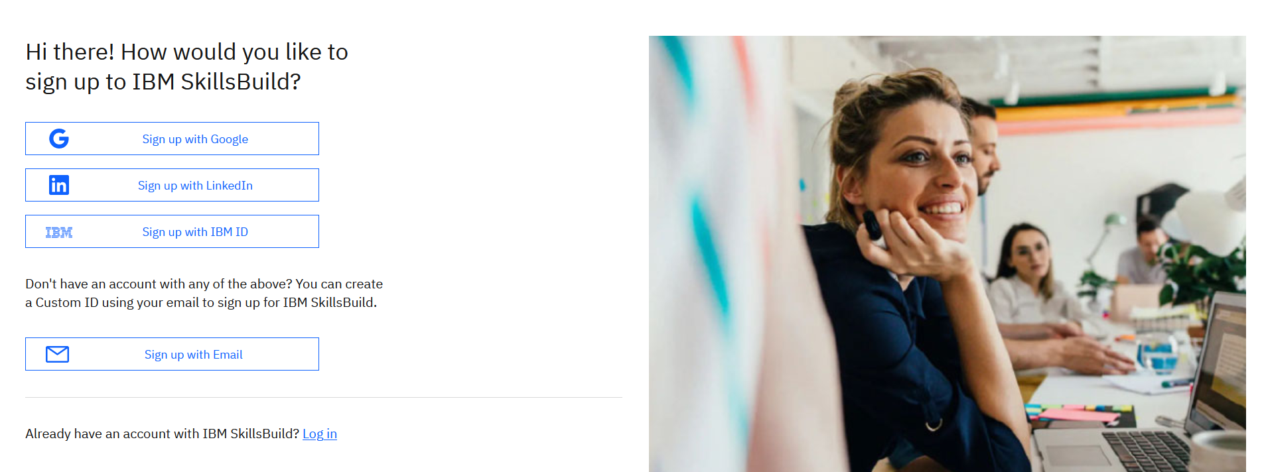
Notes:
https://skills.yourlearning.ibm.com/activity/URL-PLLV2O6UFTU?ngo-id=0107&utm_campaign=aca-Edunet-sb4aTNpoly-event1

Slide 21
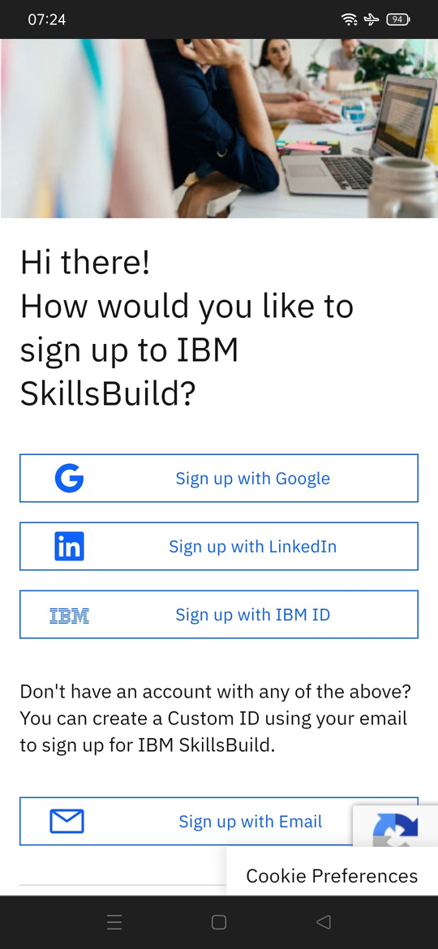
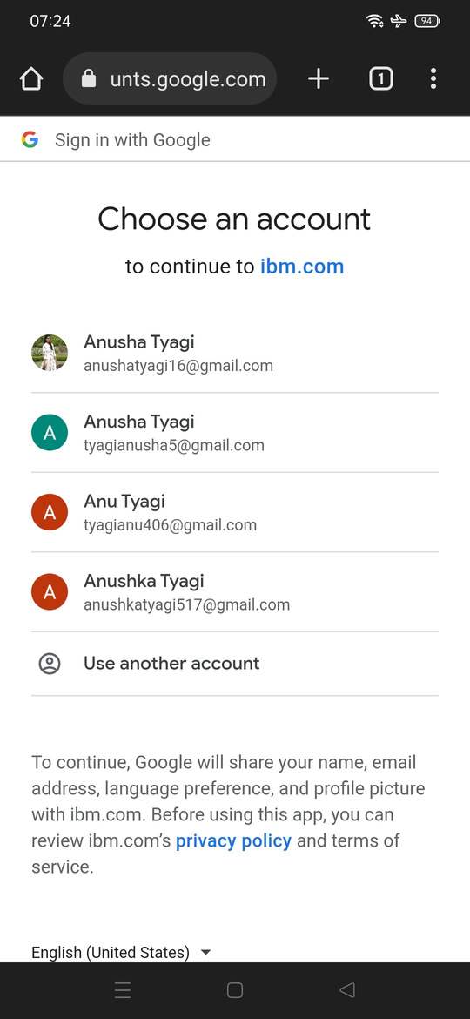
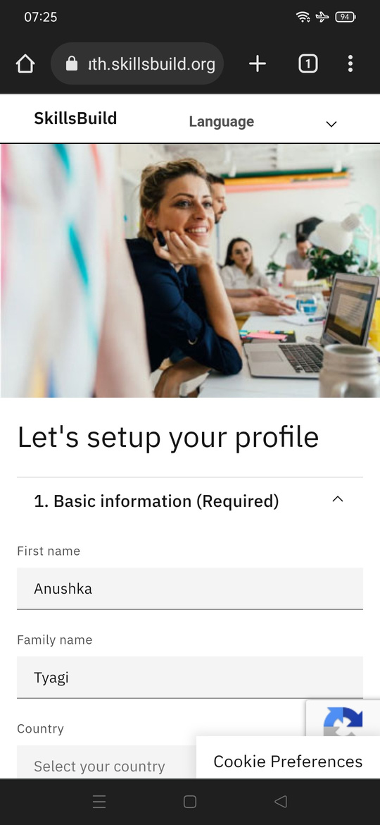
Fill your Name
Select your Country
Enter your Age
Agree to terms and Conditions

Slide 22
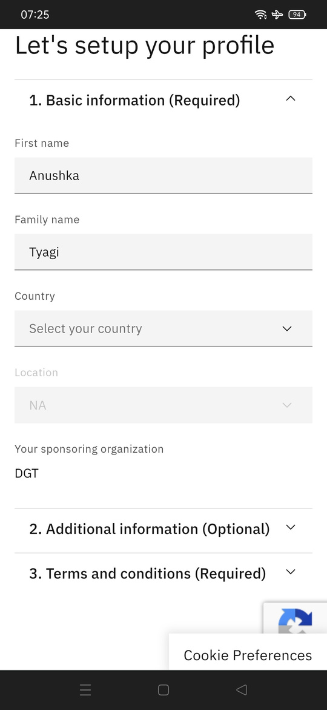
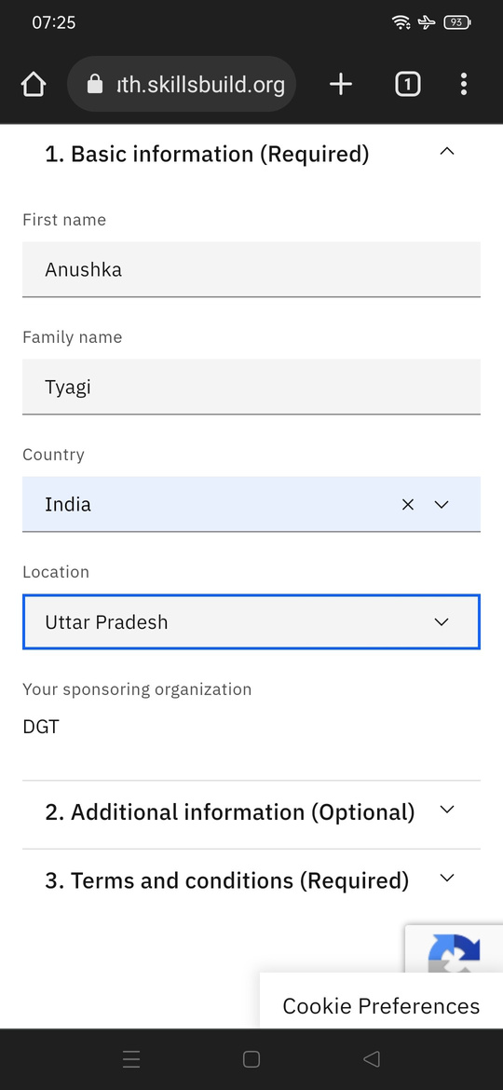
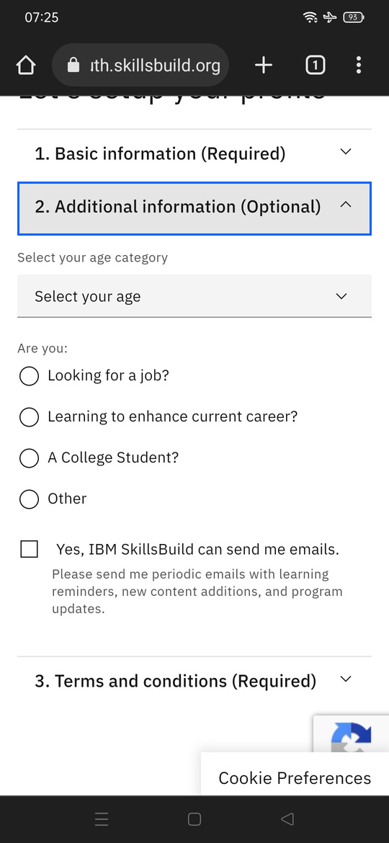

Slide 23
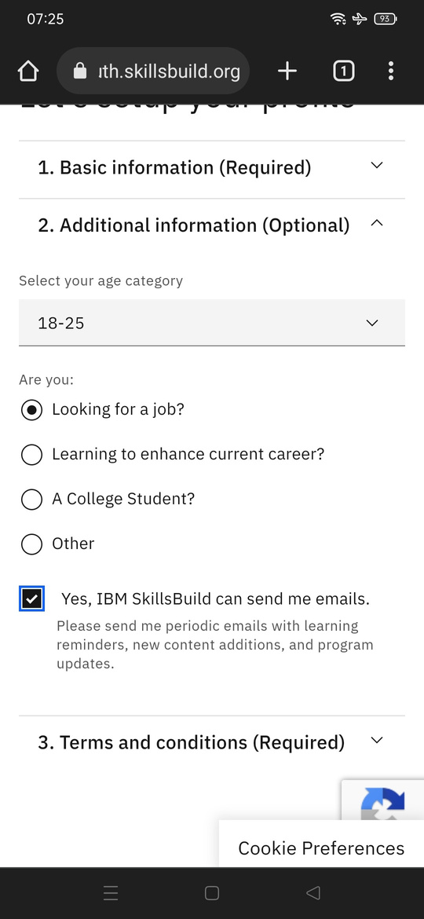
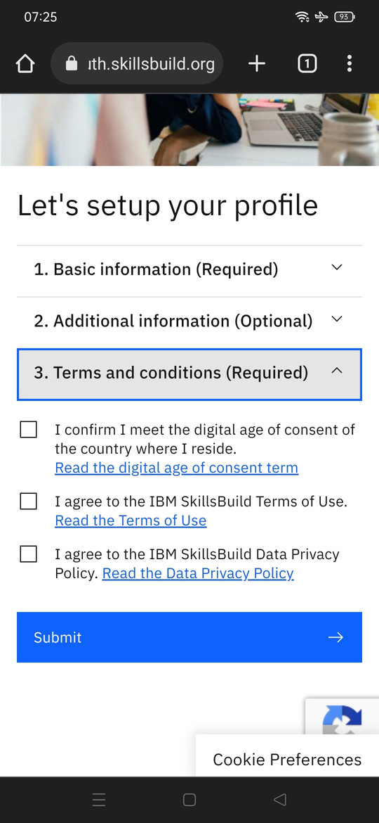
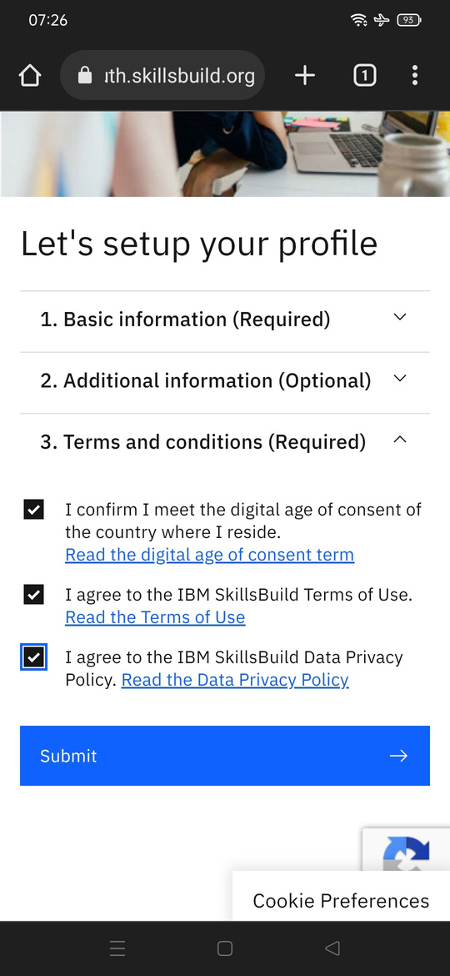

Slide 24
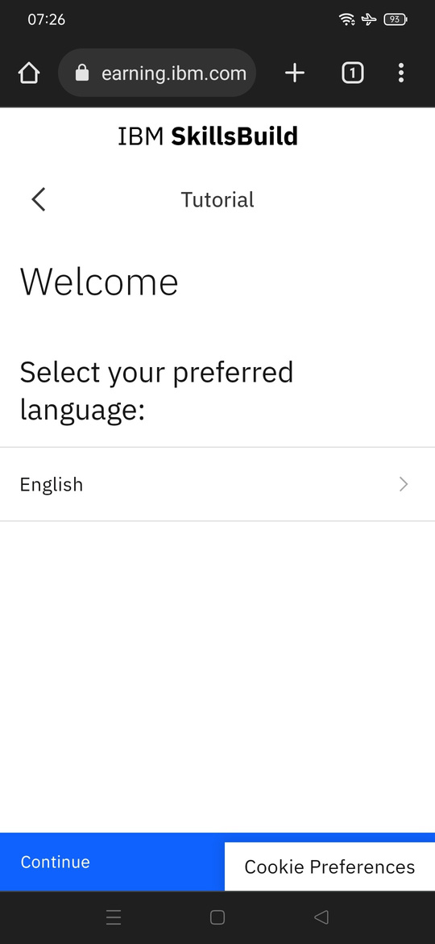
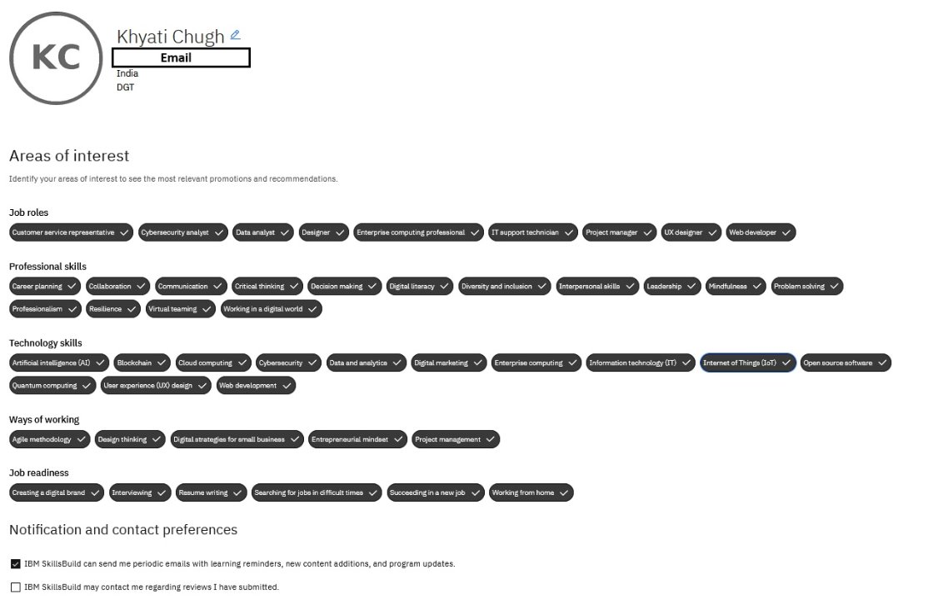

Slide 25
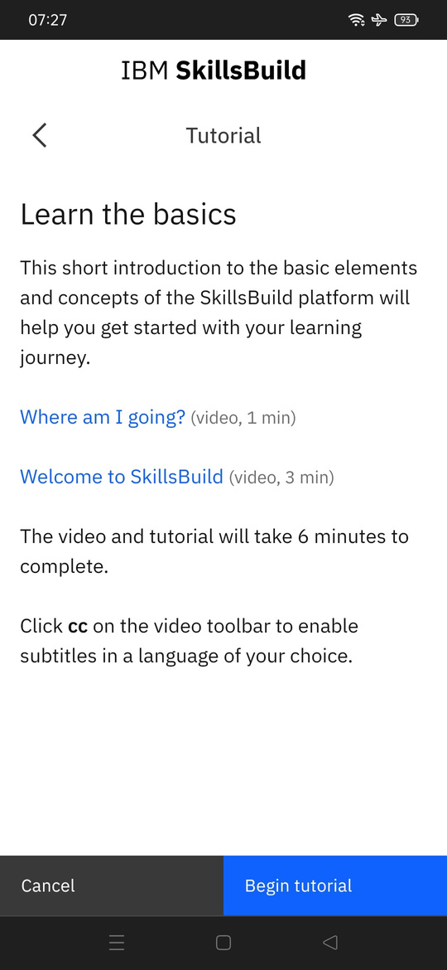
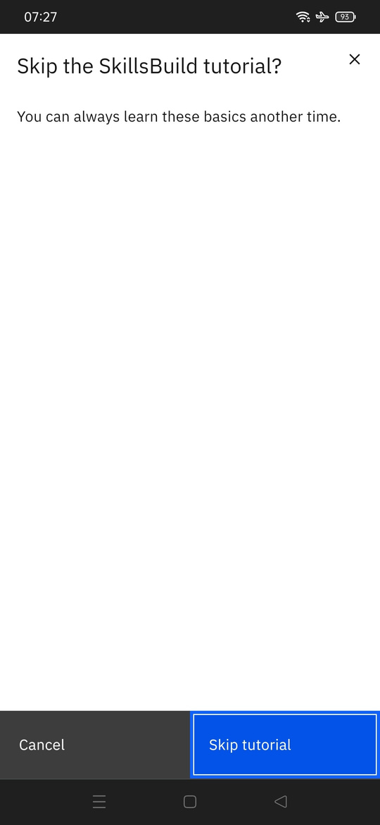

Slide 26
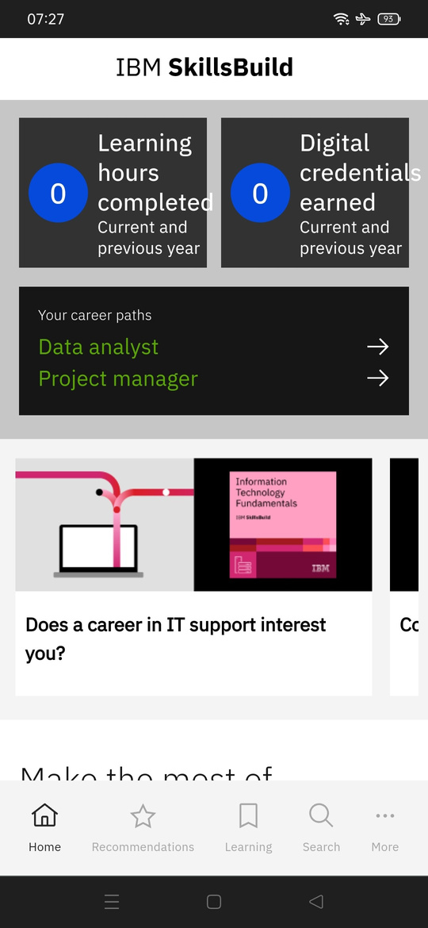
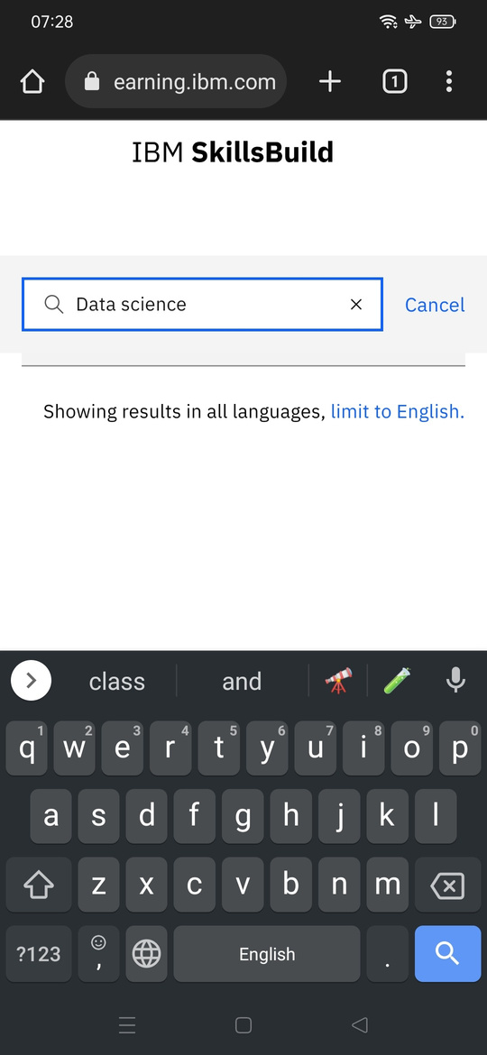
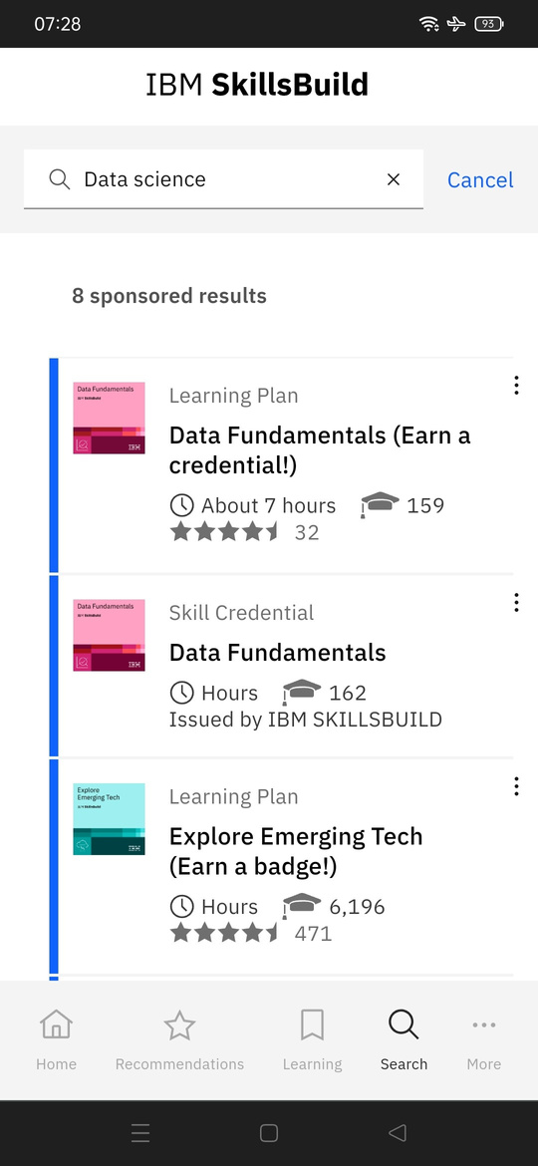

Slide 27
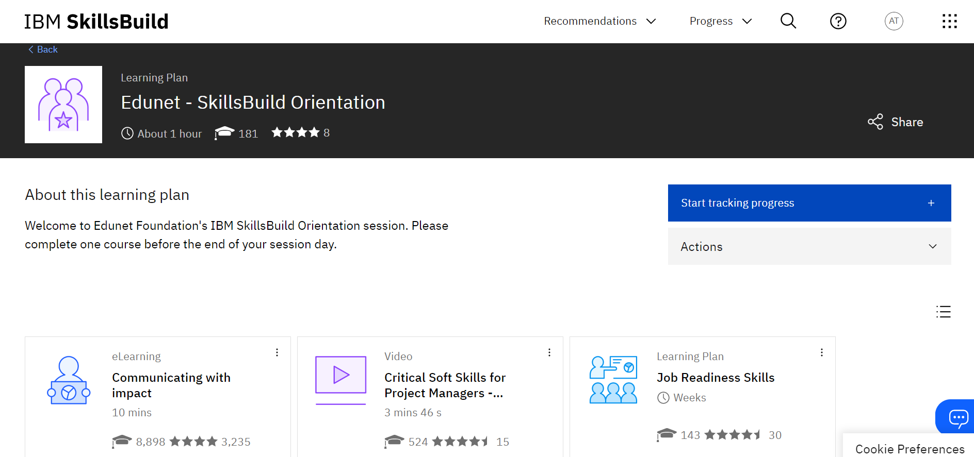
How to enrol in learning plan
Notes:
Orientation Certification Link - https://skills.yourlearning.ibm.com/activity/PLAN-04138CD348A7

Slide 28
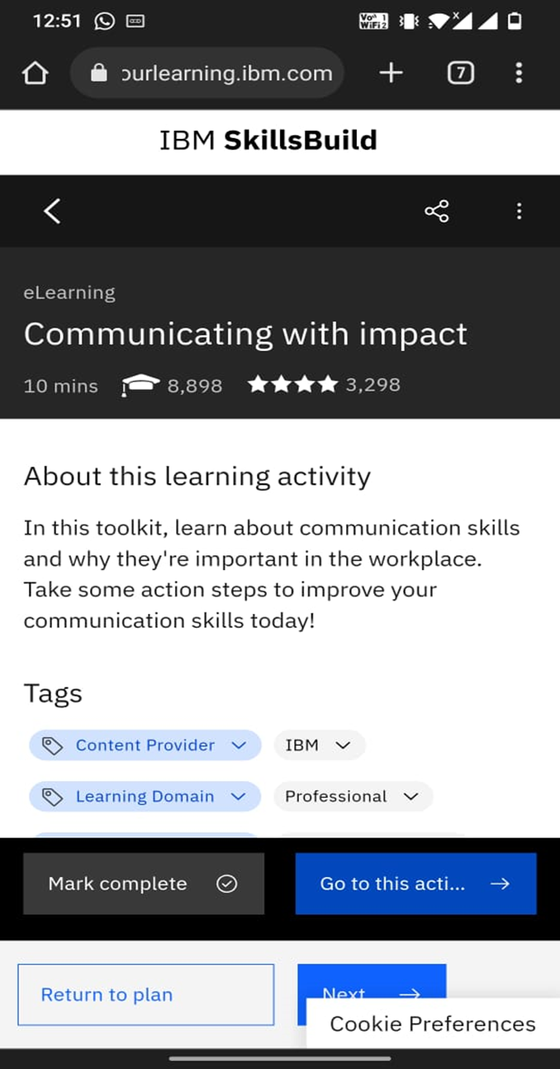
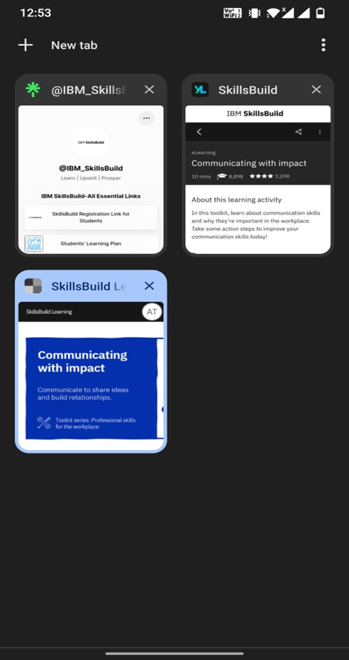
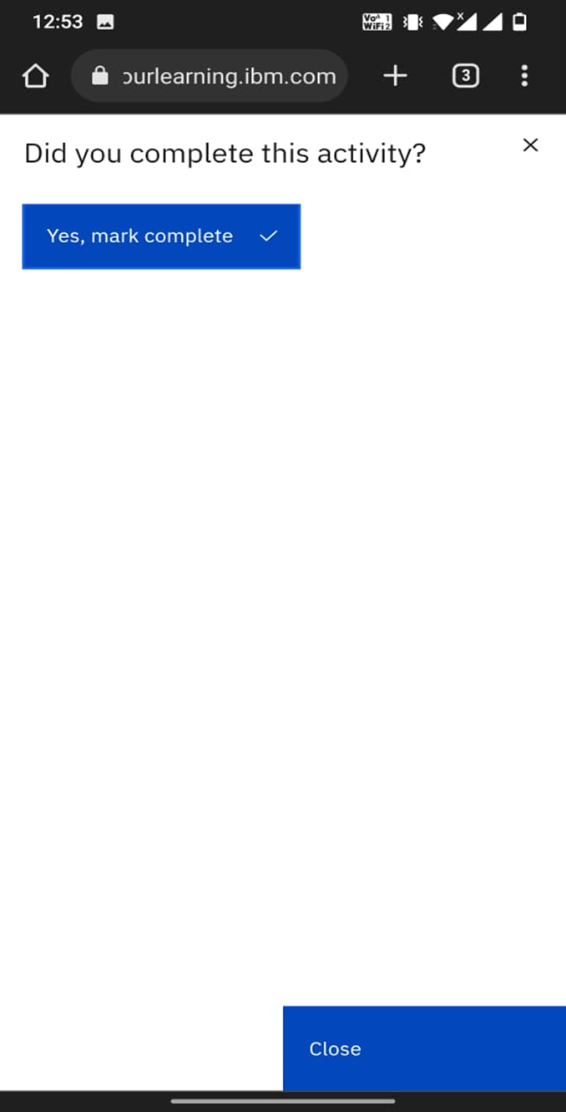

Slide 29
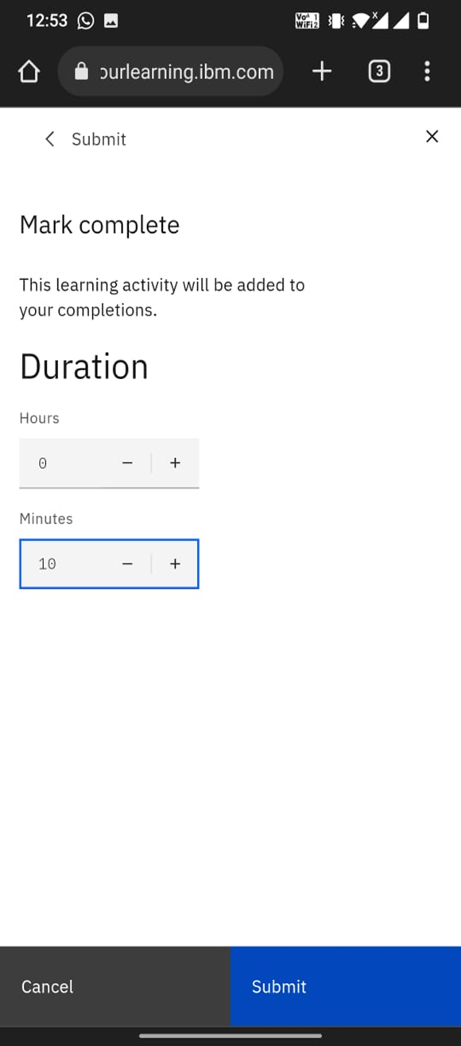
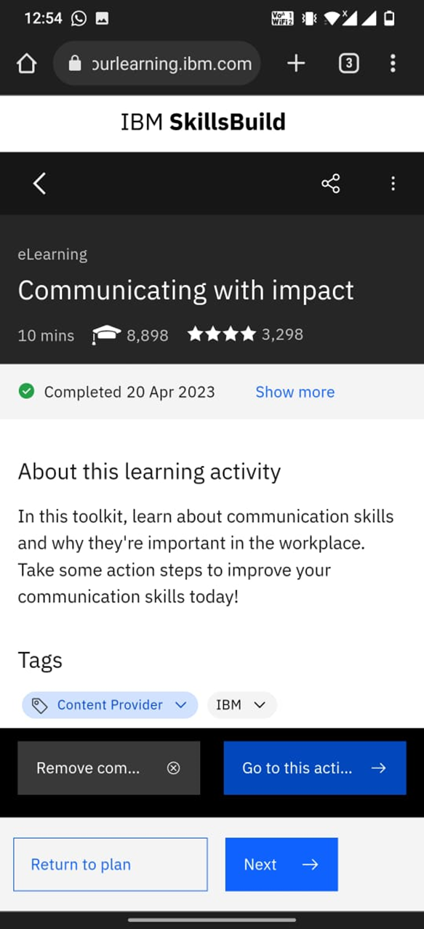
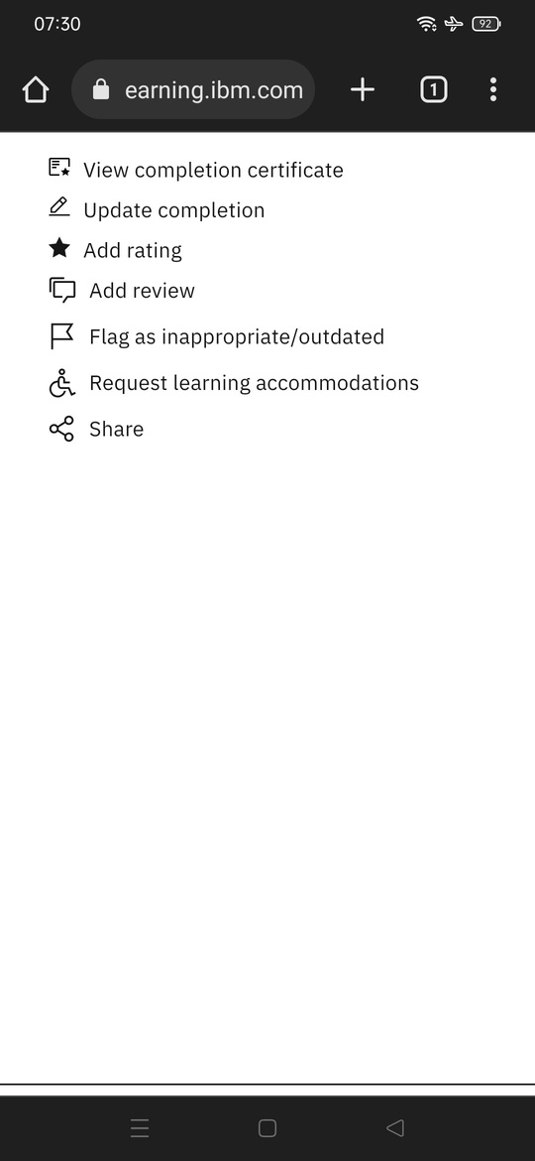

Slide 30
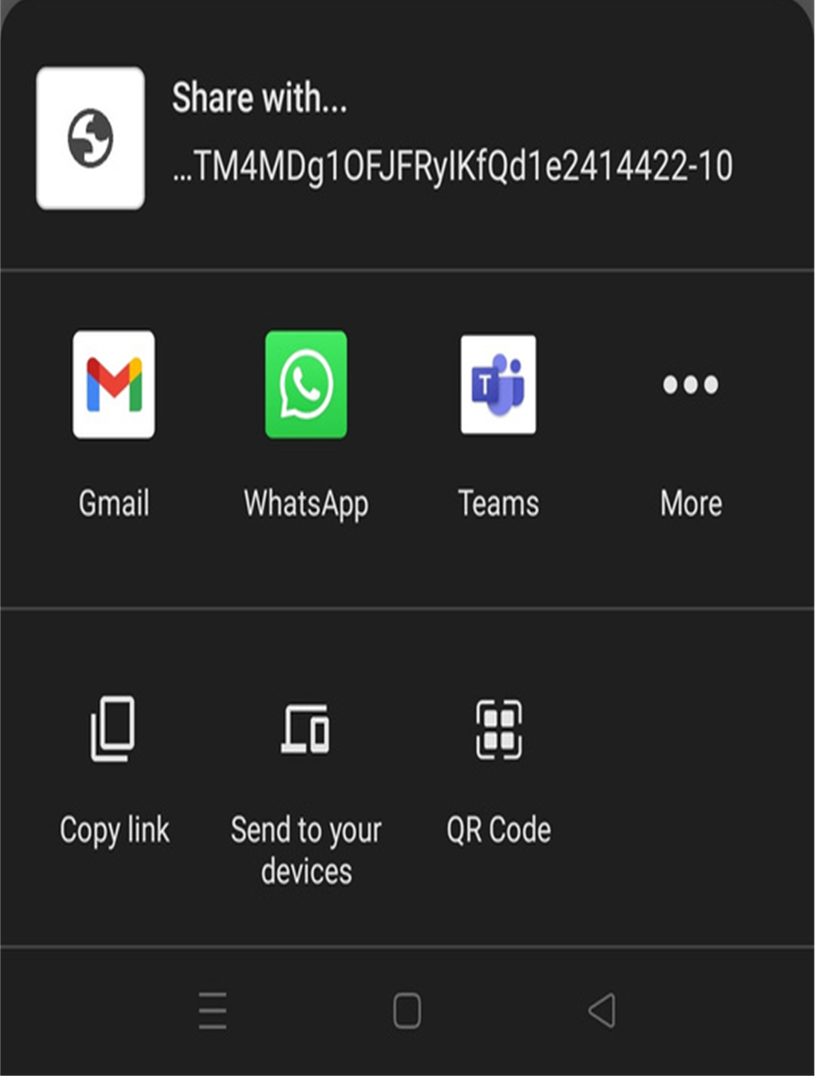
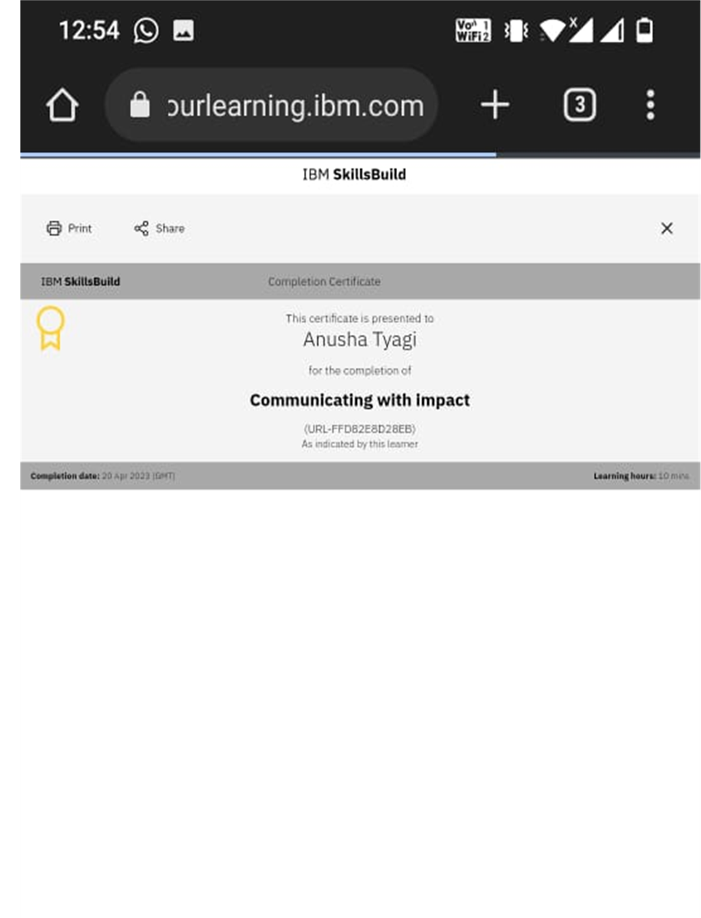

Slide 31
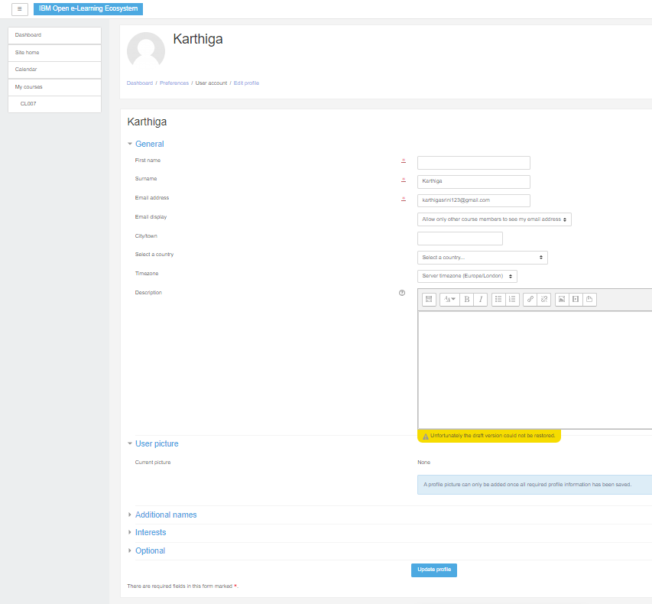
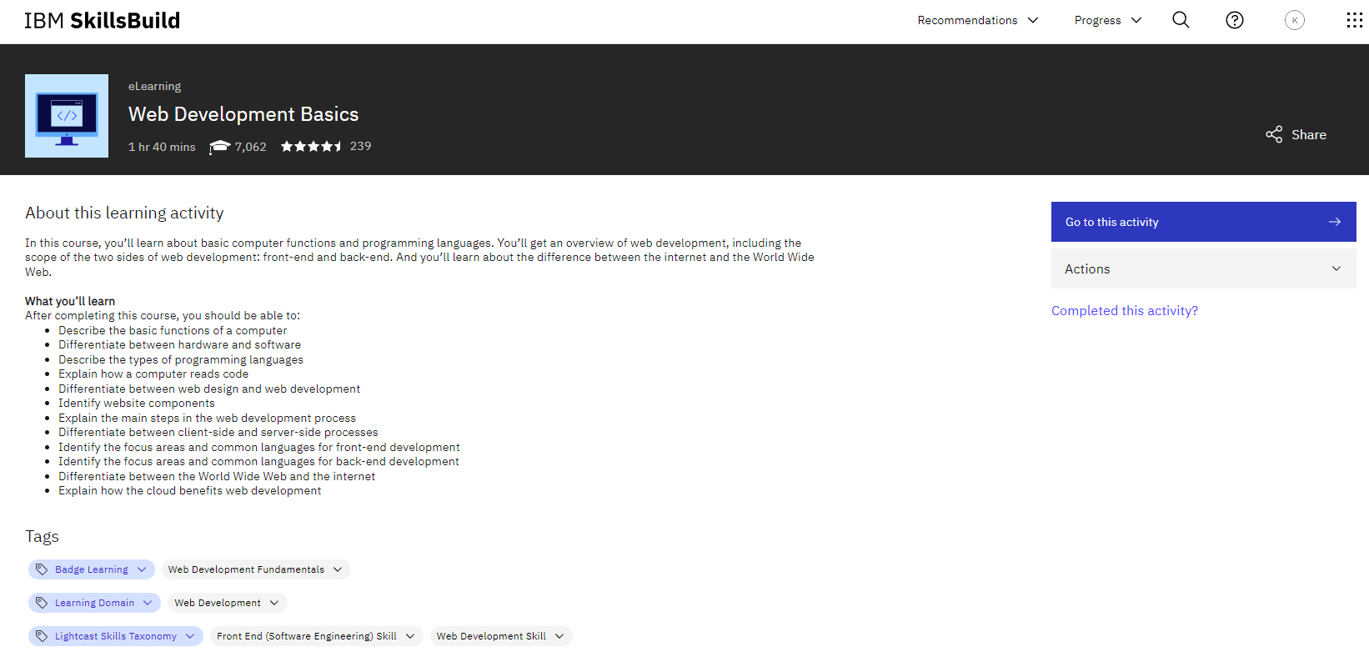
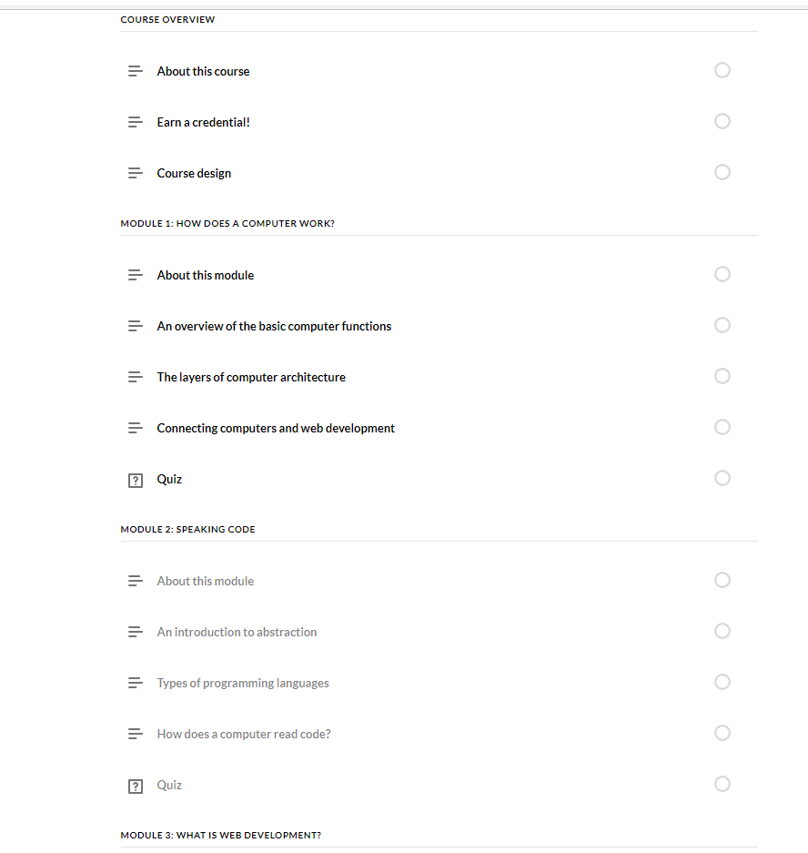
Courses with Modules

Slide 32
Student Dashboard Flow
Login on NM (Naan Mudhalvan) portal
Access Learning Plan from same page(What is SkillsBuild) on Dashboard
Session Recordings will be available on Student Dashboard on each Friday
Click on View for Mandatory Courses
Go to What is SkillsBuild and use self-registration button for IBM SkillsBuild self-registration
Post session, check your attendance under My Attendance on student dashboard
Check the course name (Digital Skills) and click on Watch
Enter your Gmail id (Double entry would be required for verification purpose) (Entering Gmail id is mandatory to access the Dashboard)
Access your session calendar from session details on dashboard
Click on Access Course
Student Dashboard On profile, check your details and NMID, same NMID will be used throughout the program
In case of any queries, click on Query button on dashboard

Slide 33

Program Process For Students

Slide 34
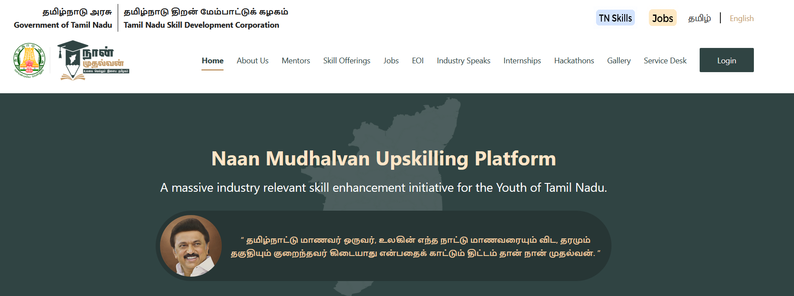
Login NM portal
Notes:
NM login link: https://portal.naanmudhalvan.tn.gov.in/login/
Username: asarts_testibmskillbuildcskl3
Password: 697127

Slide 35
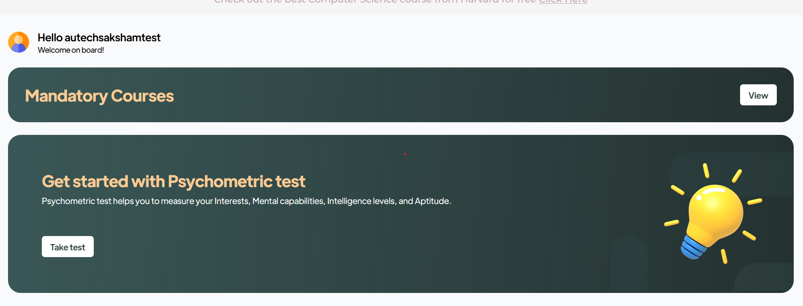

Slide 36
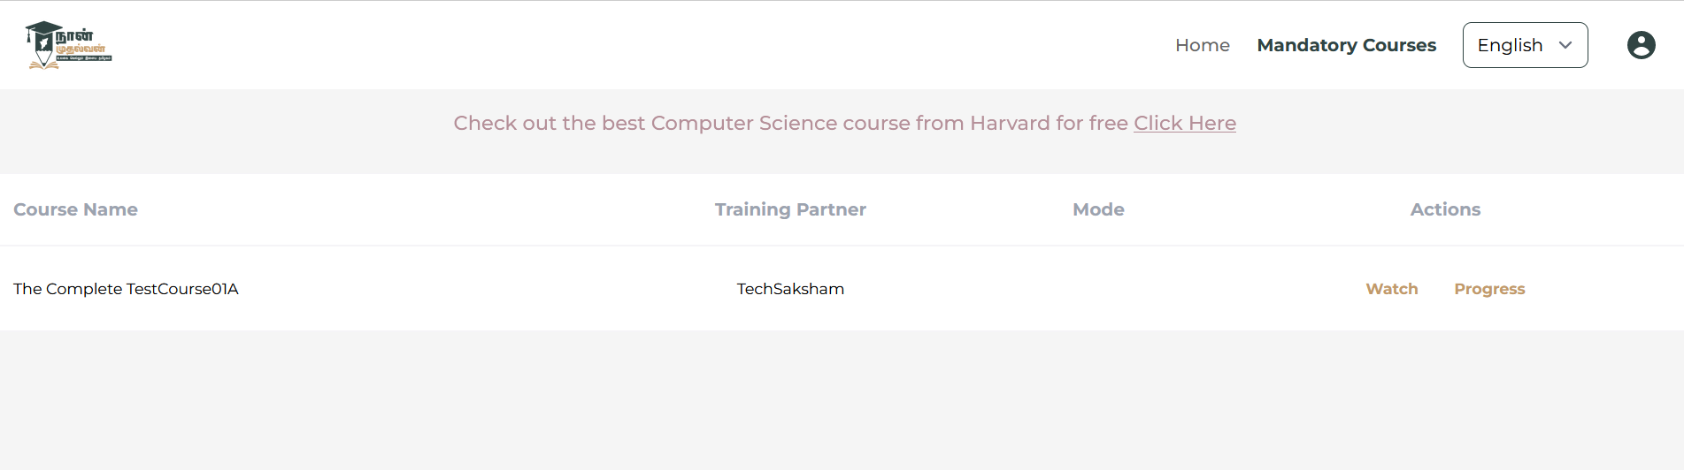
Digital Skills
IBM SkillsBuild-Edunet Foundation
Notes:
Once students will click on Watch,. They will get one pop up to access the course

Slide 37
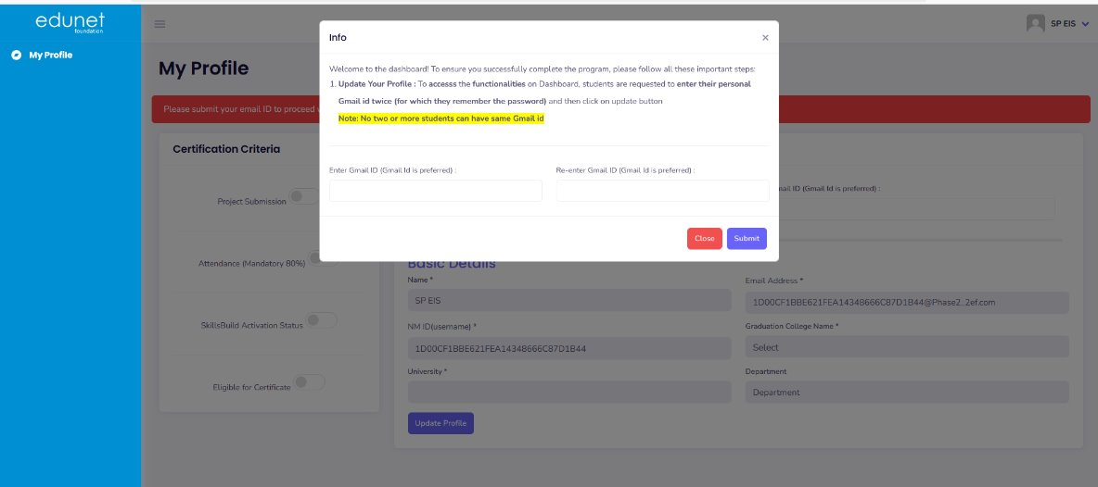
Notes:
Once students will click on Watch,. They will get one pop up to access the course

Slide 38
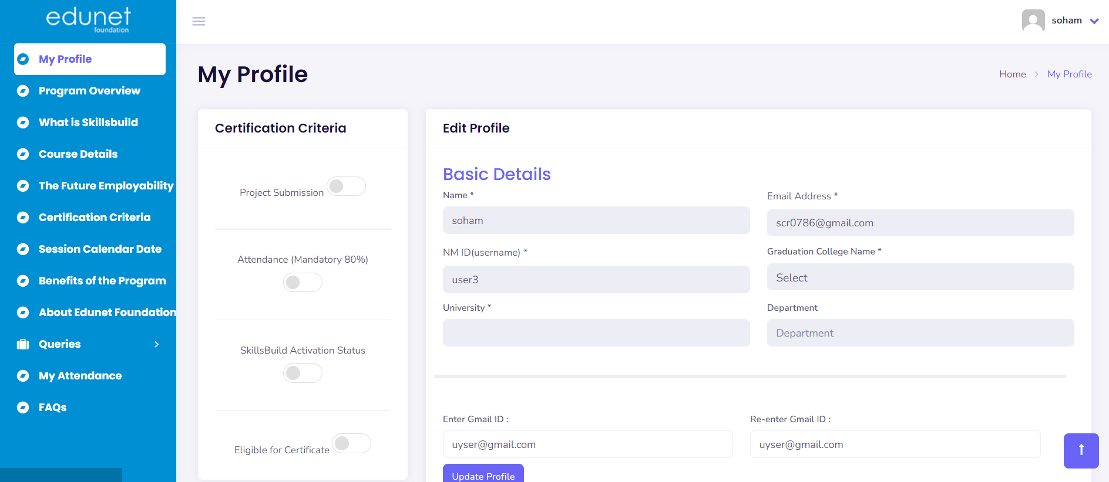

Slide 39
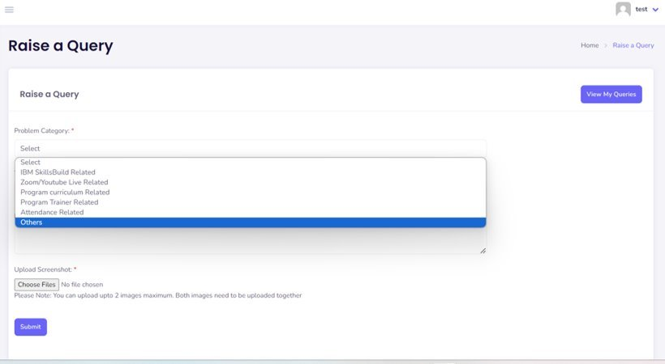
For Raising Queries

Slide 40
Functionalities available on Student Dashboard
My Profile- (NMID, Name, College, University, NM Email ID- these details will be auto fetched from NM portal), Enter Gamil id (Text Box)
Program Overview- Short description of program and its learning outcomes
What is SkillsBuild
Login IBM SkillsBuild and access the learning modules of the program
Course Details
Course Content, Session Recordings
Certification Criteria
80% Attendance
IBM SkillsBuild Course Completion
Project Submission
Session Calendar- Session date, timing and link
Benefits of Program- The industry scope of the program
About Edunet Foundation
Social Media pages
Student Query Form (In case of any queries, click on Query button)
Submission- Project Submission on Dashboard
My Attendance- Table of week wise attendance

Slide 41
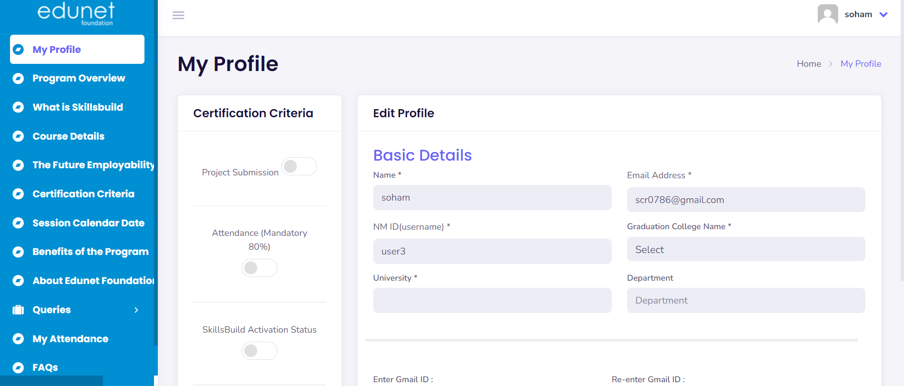

Mode of Delivery for Students
You Tube
Program Content & Session Recordings will be provided here

Slide 42
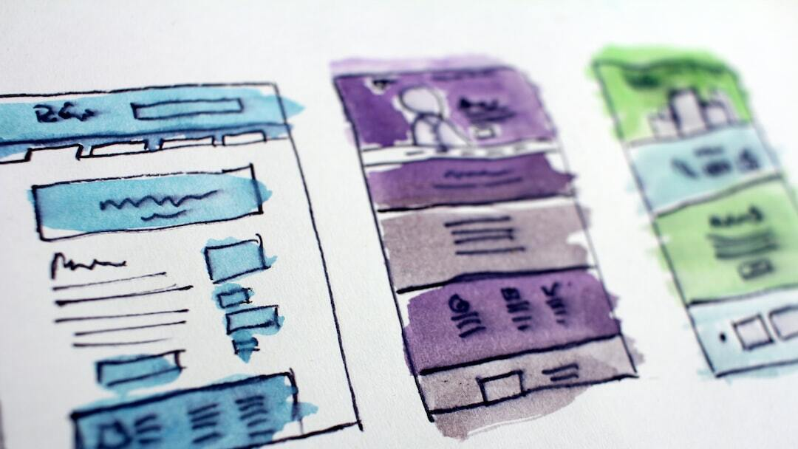
Differentiating Between Student Login Websites
Naan Mudhalvan: Students log in to view their mandatory courses. They are redirected to the Edunet Student Management Dashboard.https://portal.naanmudhalvan.tn.gov.in/login/
Edunet Student Management Dashboard: Redirected from Naan Mudhalvan, students enter their details and access learning materials.
IBM SkillsBuild: Accessed via a URL from Edunet Dashboard. Students complete required courses on this platform. https://sb-auth.skillsbuild.org/signup?ngo-id=0107

Slide 43
Thank you!
Notes:
Program Overview
Registration on IBM SkillsBuild
Student Process from Naan Mudhalvan
SkillsBuild Registration Link - https://sb-auth.skillsbuild.org/signup?ngo-id=0107
Learning Plan Link - https://skills.yourlearning.ibm.com/activity/PLAN-26986AC544CB

